Slide 1
Language and Literature:
Best Practices in the English Language Arts Classroom
University of South Florida
Adolescent Learner Research Lab

Slide 2
Socratic Seminar
Erin Parke
EHART@MAIL.USF.EDU

Slide 3
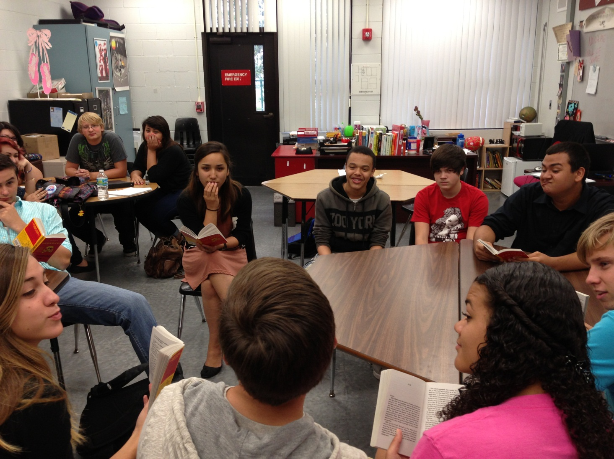

Slide 4
Introduction
Students read content ahead of time
  Either for homework or in a previous class
  Have annotated and developed questions for discussion
Discussion questions can be text based, open-ended, etc.
  Preferably a combination
Students are arranged in a large circle
  Either whole class or partial, teacher choice.

Slide 5
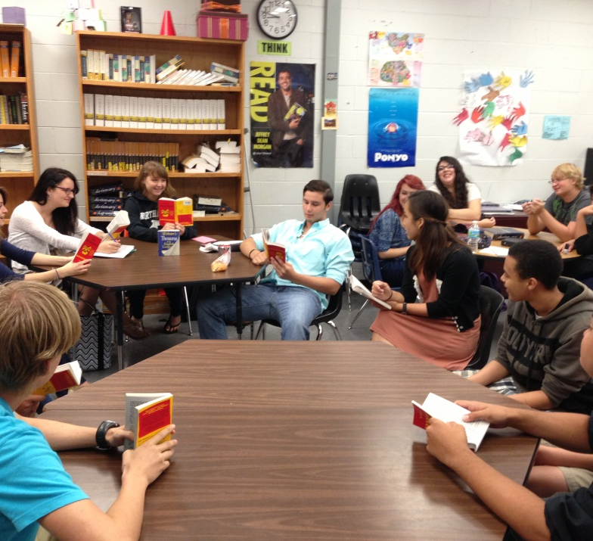
During the seminar
Students are in charge!
The teacher pops in only as needed
Students on the outer circle are in charge of keeping the inner circle in check
Students become experts after several sessions… expect the first ones to be messy!

Slide 6
Using Special Interest Areas to Support Students with High-Functioning ASD
Laura D. Sabella
lsabella@mail.usf.edu

Slide 7
Rationale for Using
Special Interest Areas
Language Deficits
  Spoken language competence and social skills
  Reading comprehension
  Writing proficiency
  Motivation and engagement
Strengths with Special Interest Areas
  Increased spoken language competence, social skills and topic maintenance
  Increased reading comprehension and vocabulary
  Increased interest in writing
  Increased motivation and engagement

Slide 8
Using Special Interest Language in the ELA Classroom
For reading
  Allow access to material on Special Interest Area
  Motivation to read and answer comprehension questions is high
  Relate other material to the SIA through comparison and contrast
  Use a human being related to the SIA to link to character or author (affective) questions

Slide 9
Using Special Interest Language in the ELA Classroom
For writing
  Allow “knowledge telling” writing first
  Give explicit writing instruction that calls attention to the reader’s needs (impaired Theory of Mind)
  Allow comparison and contrast with SIA
  Encourage the use of a SIA human to teach aesthetic stance
  Use SIA to reward and motivate

Slide 10
Using Special Interest Language in the ELA Classroom
For listening, speaking and social skills
  Use of SIA allows for instruction on appropriate listening body language
  Use SIA to instruct for prosody, eye contact, and topic maintenance
  Note increase in vocabulary
  Discuss topic maintenance and listening to others
  Use interest to encourage social acceptance through clubs or discussion

Slide 11
Using Special Interest Language in the ELA Classroom
For motivation
  Increase reading and writing opportunities that center around the SIA
    The same skills can be taught with the SIA that can be taught with other reading material
    Link less preferred reading and writing material to the SIA
    Use the Premack Principle – reward participation in less desired activities with time to read or discuss the SIA

Slide 12
What is my student’s SIA?
Ask the student
Ask caregivers
Encourage the student and caregivers to bring in some prized reading material to keep in the classroom
Find other materials and keep them in your classroom readily available
Allow student to research the SIA to bring in more materials

Slide 13
Literature Circles
Ruchelle L. Owens
rowens@mail.usf.edu

Slide 14
Literature Circles (LC) Intro
Peer-led discussion in small groups
Designed to facilitate responsibility
Flexible in design
H. Daniels
1996 ELA strands support lit-based collaboration
  NCTE
  IRA

Slide 15
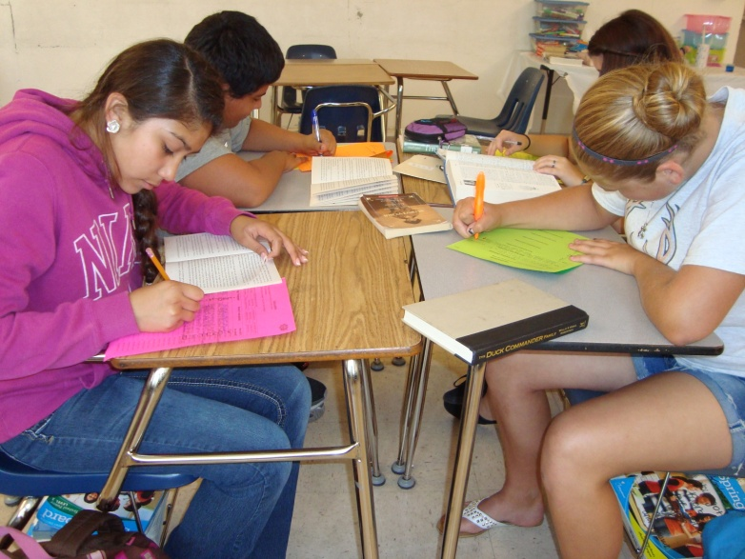
11 Official Points to LC’s
(Daniel, 2001, p. 18)
Students choose text
Small groups
Different groups read different texts
Regular schedule
Notes guide discussion
Discussion topics come from students
Natural conversations
Teacher facilitator
Evaluation from teacher observation and student self-eval
Fun playfulness
Share with class

Slide 16
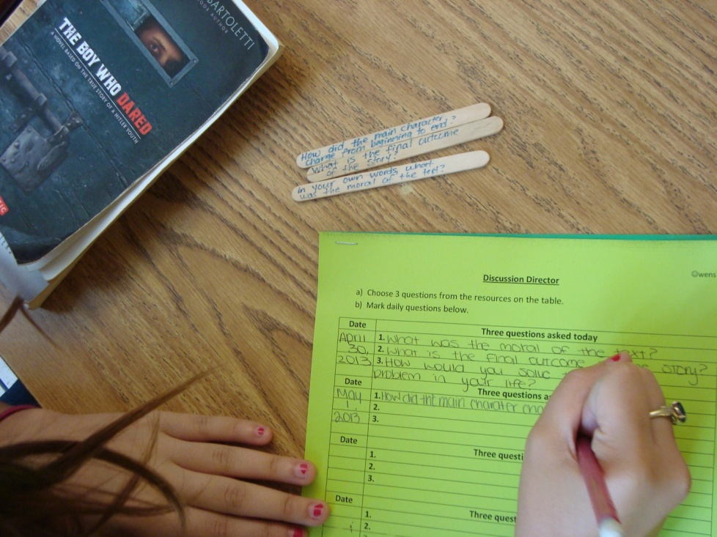
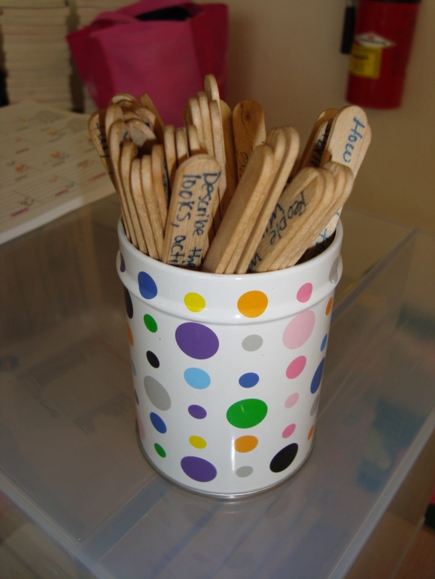
In My Class: Discussion Director
Writes 3 questions to be used for discussion
Promotes high level thinking

Slide 17
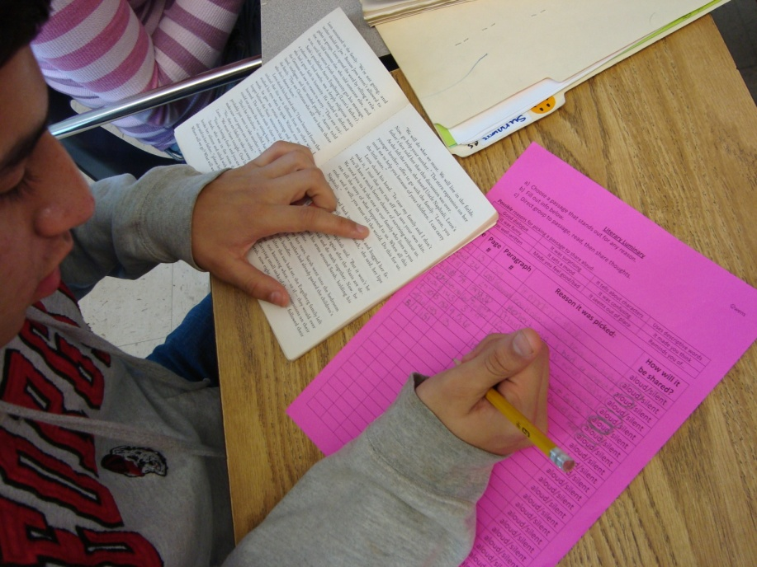
In My Class: Literary Luminary
Highlights passage that stood out
Promotes analyzing and debate

Slide 18
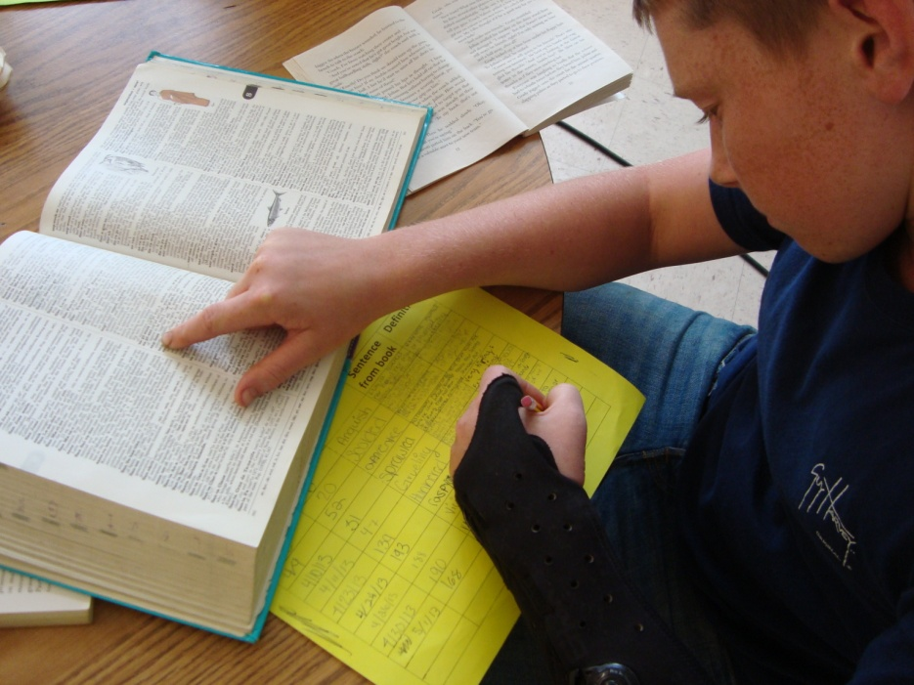
In My Class: Vocabulary Enricher
Finds new vocabulary word
Challenges students to use context clues

Slide 19
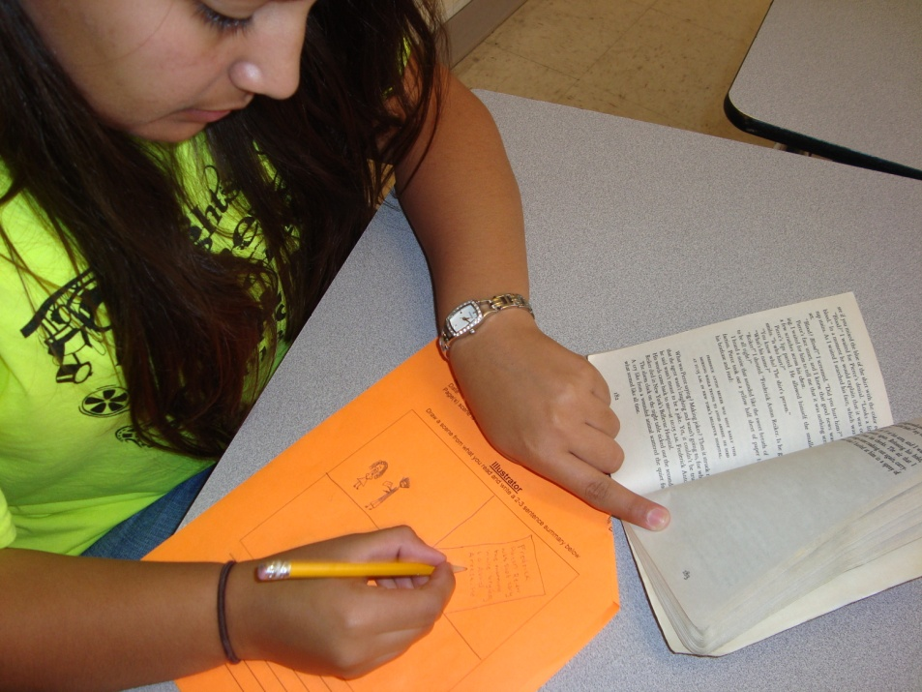
In My Class: Illustrator
Draws salient scene
Group engages in fun admiration

Slide 20
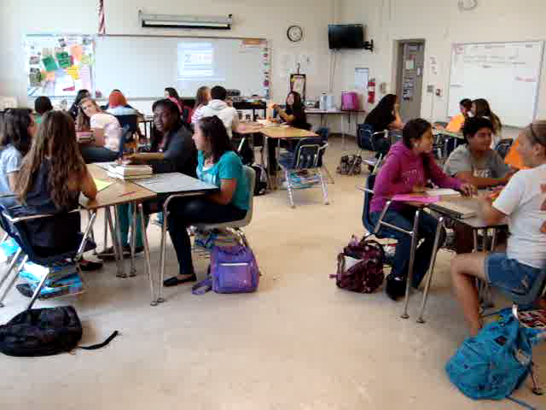
What It Looks Like (in 7 seconds)

Slide 21
Poetry
Jennifer Denmon
jdenmon@mail.usf.edu

Slide 22
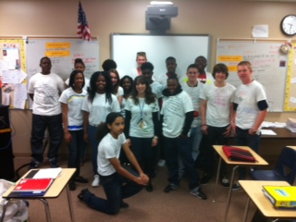
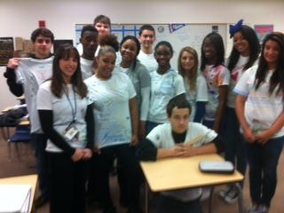

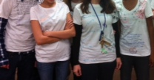
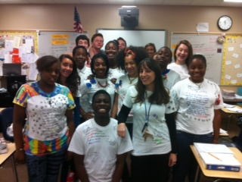
Poetry
Poetry unit
  Choice
  Contemporary and classic
Write and share poetry
Po-e-tees

Slide 23
Digital Writing
Bridget Mahoney

Slide 24
Digital Writing in Middle School Classrooms
Digital writing is…
  “when we use the term “digital writing,” we refer to a changed writing environment- that is, to writing produced on the computer and distributed via networks.” (Grabill and Hicks, 2005, p. 304)
  A change agent in writing instruction
    Opportunities for collaboration
    Potentially global audience
    Multi-model compositions

Slide 25
Digital Writing Tasks
Digital writing is not…
  Typing a final draft on a computer
  Submitting a final draft via an online submission system to the teacher
Things to consider…
  Is the technology appropriate for the assignment?
  How does using the technology enhance the assignment?
  What supports are available when using this technology for students? For the teacher?
  How will you ensure student safety?

Slide 26
Digital Writing Resources
National Writing Project’s Digital Is
  http://digitalis.nwp.org/
School Collaboration
  http://www.wikispaces.com/
Global Classroom Collaboration
  http://www.epals.com/
  http://www.flatclassroomproject.net/index.html

Slide 27
Book Talks
Michael DiCicco

Slide 28
Bi-weekly Book Talk Groups
Bi-weekly students in their literature circles would talk about the individual books they were reading
Students:
  Were more likely to keep up with reading logs
  Became interested in each other’s books (especially books in genres they haven’t considered before)
  Were exposed to many books over the course of a semester
  Practiced summarizing

