Slide 1
Social Justice in the Standards
Critical Pedagogy and Common Core

Slide 2
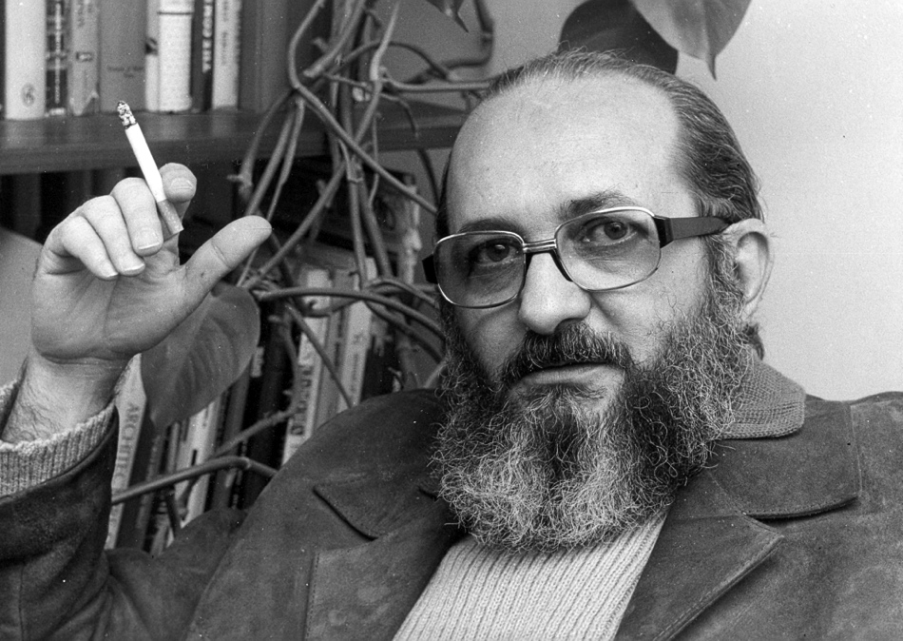
Critical Pedagogy
An overview

Slide 3
Pedagogy of the Oppressed
Freire 1968
  Liberation through education
  Focus on literacy
  Literacy leads to personal realization and empowerment
Influenced Giroux, McLaren, hooks, etc

Slide 4
Major tenets
Conscientization
  Critical consciousness
Dialectical Teaching
  Teacher in dialogue
  Teacher must accept they learn from the students

Slide 5
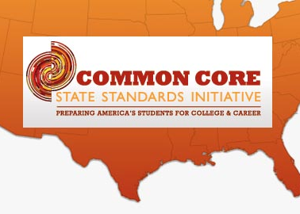
Common Core and Critical Pedagogy
Can they work together?

Slide 6
Being critical of the CCSS
Invites input from teachers
Promises to not “tell teachers how to teach”
Does this offer more freedom in the classroom?
Newness offers us chance to intepret
What does it offer to teachers?

Slide 7

Diving into the Standards
Issues by strand

Slide 8
Reading and CCSS
Allows for student choice
  Student reading must be relevant to their lives and experiences in order to make meaning
    Leads students to make connections to the real world and oppressions they may face (McLaren, 1999)
Teacher choice
  Offers exemplar list, but stresses it is not exhaustive

Slide 9
Sample texts (High School)
CCSS Exemplar
Additional possible texts
Fahrenheit 451
To Kill a Mockingbird
The Book Thief
The Bluest Eye
Copper Sun
  Relatable, teenage narrator
Every Day
  David Levithan

Slide 10
Writing and Language Standards
Vocabulary and grammar in context
  Organic rather than rote memorization
Focus still on Argumentative and Informative
  Teachers must add other types of writing

Slide 11
Language
CCSS Promotes the use of standards English, but recognizes variations of English
  Allows teachers to justify the use of other dialects in some projects and class writing
    Showing value for student language is vital to their success

Slide 12
References
Freire, P. (2009, 1968). Pedagogy of the Oppressed. New York, NY: Continuum.
McLaren, P. (1999). A pedagogy of possibility: Reflecting upon Paulo Freire's politics of education: In memory of Paulo Freire . Educational Researcher , 28 (2), 49-54+56.

